Slide 2
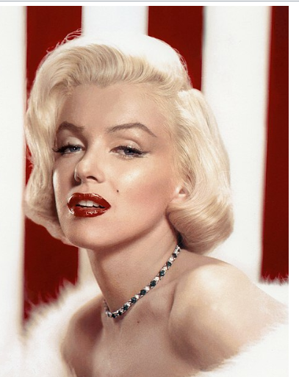
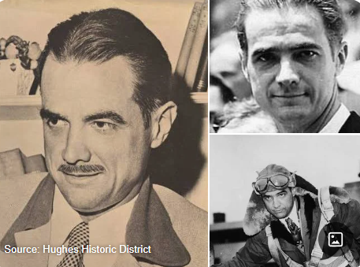
Marilyn Monroe
Howard Hughes

Slide 3
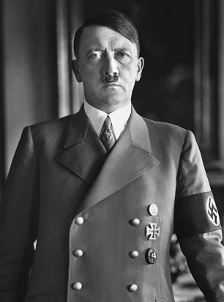
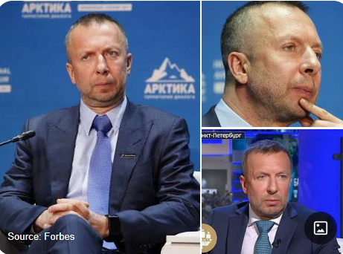
Demitry Bosov
Adolf Hitler

Slide 4
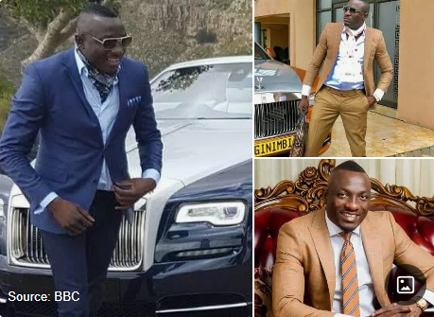
Genius Kadungure

Slide 6

Be Rich in the Kingdom of GOD
1Timothy6:17-19
Sis. Liezel

Slide 7
I. R-ooted in God's Word(Col.2:7)
*Growth
*Stability.
*Deep connection

Slide 8
I. R-ooted in God's Word(Col.2:7)
-Devote ourselves to: PRAYER...
* 5 Promises when we PRAY:
1.Strength to be able.....
2.Forgiveness
3.Knowledge&Guidance
  4.Desiring to do God's will
  5.Peace

Slide 9
II. I-nvested in Eternity (Mat 6:19-21)
*eternal value
*Prioritize spiritual Growth

Slide 10
III. C-hrist centered life. (Galatian 2:20)
*Supreme Focus is
JESUS Christ
-thoughts
-desire
-actions

Slide 11
IV. H-OPE that never Fails(HEB.6;19)
*Supreme Focus is
JESUS Christ
-thoughts
-desire
-actions

Slide 12
Conclusion:
Being RICH in the Lord ;it is our strong Foundation in our life ; that no matter what trials, challenge & problem comes along your way . the love & faithfulness of God remain to His people.

Slide 13


